Slide 1
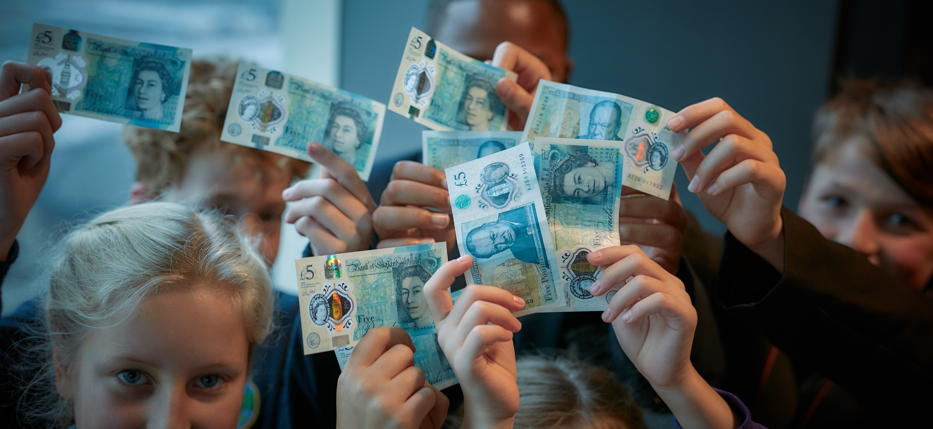
WEEK 3
Fiver Challenge
Notes:
Teacher Notes
Week 3:
This PowerPoint presentation provides…
A reminder of the tasks the pupils will need to think about and complete that week, together with a list of resources that will help them.
An activity that is linked to the tasks for that week to help them to succeed.
Note: Depending on how much time you have in advance of the challenge you may want to do some of the introductory activities earlier.

Slide 2
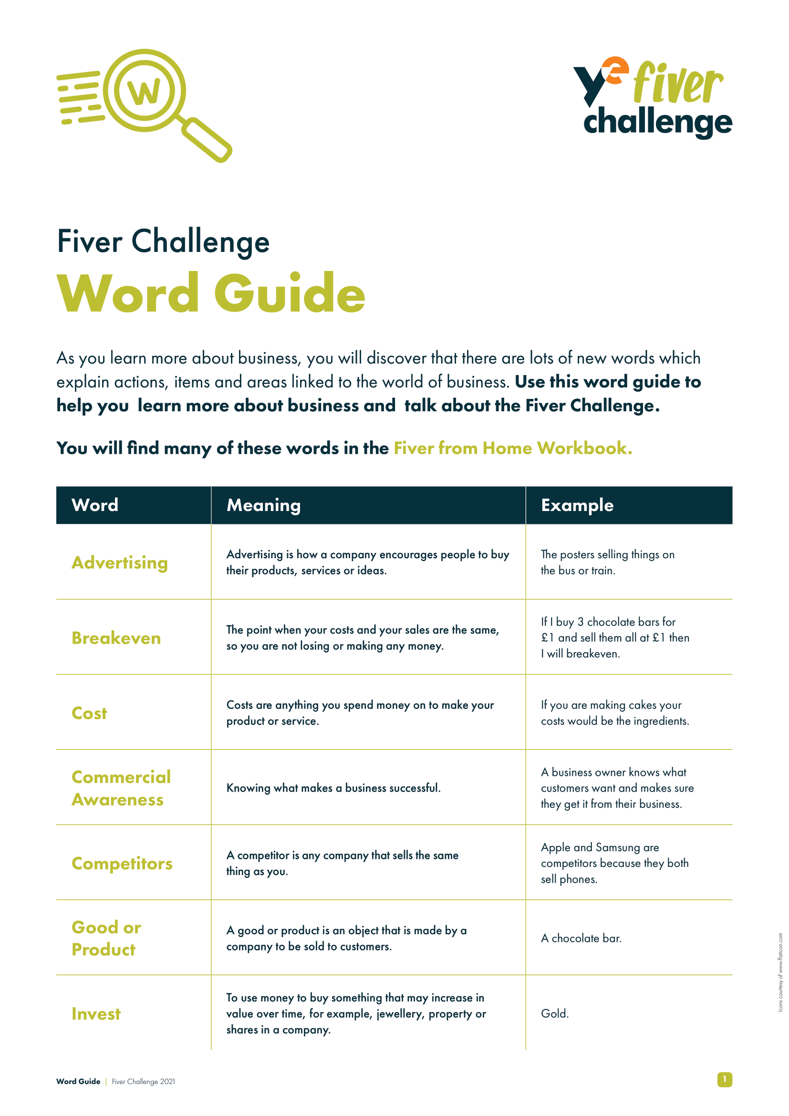
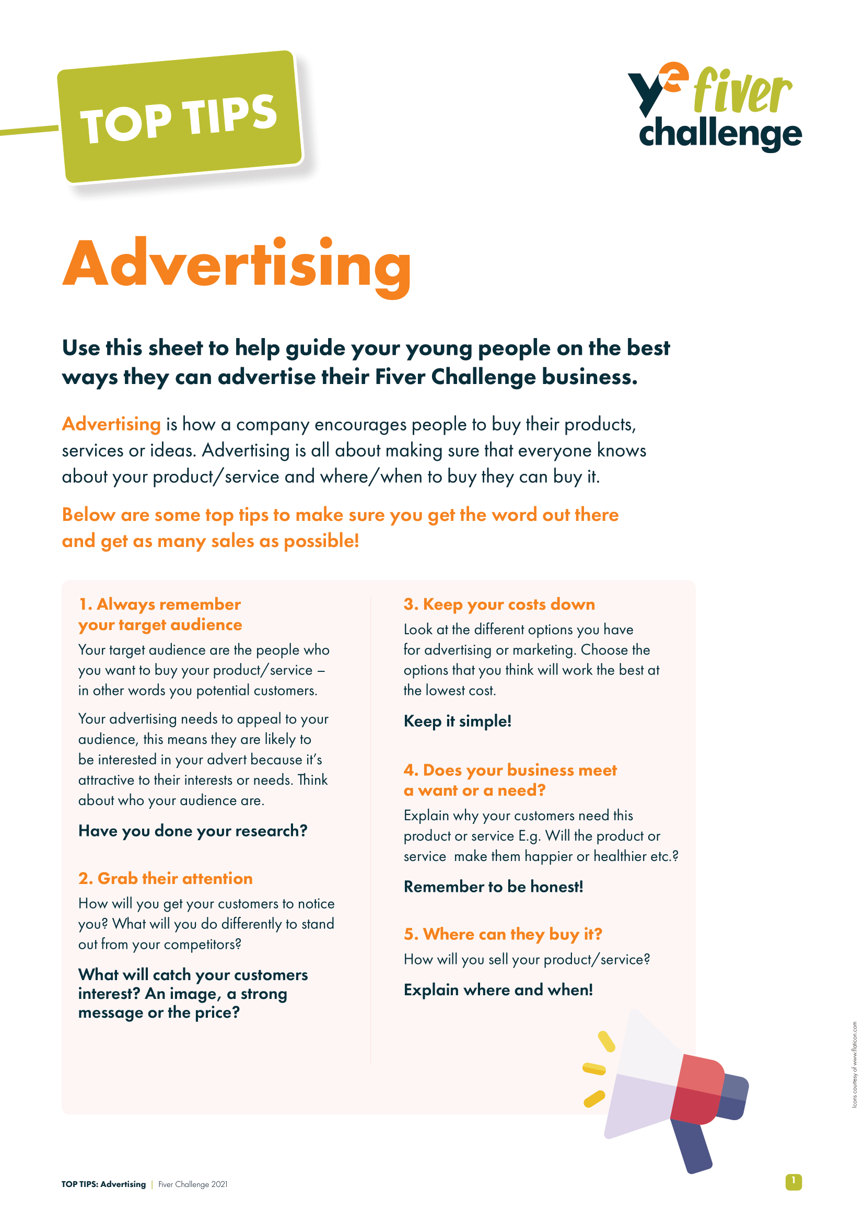
Keep It Going!
You will need:
Fiver Challenge Workbook
Fiver Challenge Word Guide
Top Tips for Advertising
Top Tips for Pop-Up Shops
Notes:
Teacher Notes
This slide maps out what resources are available to pupils during Week 3.

Slide 3
Keep It Going!
What you need to do:
Get your product or service ready to sell.
Keep track of your spending.
Decide on your advertising.
Promote your selling event.
Check you are ready to go.
Enter the Sales Pitch Competition!
Discuss: How can we support other people? How can you share information about your Fiver Business with others?
Notes:
Teacher Notes
Following the available resources for Week 3, this slide maps out what specifically pupils will need to do during Week 3.
Skills Builder Essential Skills
Teamwork - Step 4: I work well with others by supporting them if I can do so
To incorporate the essential skill, ask the following reflective question when covering this slide:
How can we support other people?
Problem Solving - Step 3: I complete tasks by finding information I need myself.
Problem solving is the ability to find a solution to a situation or challenge. Talk to students about further information they might need to find out when thinking about their branding. Do they need further examples? Do they want to look at what similar products or services have done? Get them to think about where they might find that information.
To incorporate the essential skill, ask the following reflective question when covering this slide:
How can you share information about your Fiver Business?

Slide 4
Ready to Sell?
This week you will be focusing on getting your product or service ready to sell at your pop-up shops!
During this time, you’ll figure out what each team members strengths are and how to work as a team to create a successful product or service.
Think: How can you use your strengths to support others? What would happen if we avoided new challenges?
Notes:
Teacher Notes
For Week 3, pupils should be ready to sell their product or service and will get to grips with the finances of running their own Fiver business.
Remind them that they will be using their teamwork skills as they work collaboratively to successfully create their products or set up their service.
Skills Builder Essential Skills
Teamwork - Step 4: I work well with others by supporting them if I can do so.
Teamwork is the skill of working cooperatively with others towards achieving a shared goal. Explain that across the challenge students will need to support each other and discuss what this might look like and why it is important. Students could identify situations for this week’s task where they think they will need to support others.
To incorporate the essential skill, ask the following reflective question when covering this slide:
How can we use our strengths to support others?
Aiming High - Step 4: I work with a positive approach to new challenges.
Aiming High is the ability to set clear, tangible goals and devise a robust route to achieving them. Explain to students that they will undoubtedly encounter challenges across the project but that it’s important to have a positive attitude to new challenges. Students could talk about why they think it is necessary to do this.
To incorporate the essential skill, ask the following reflective question when covering this slide:
What would happen if we avoided new challenges?

Slide 5
Advertising
How can you promote your product or service?
Social media, posters or word of mouth?
Pop-Up Shop or join an event?
Sell at a local market?
Contact your local community?
Local radio or press?
Use your Top Tips for Advertising guide to help you gain engagement at your pop-up shop, or if you’re selling to your friends or family!
Think: How do we know what information is most useful to us?
Notes:
Teacher Notes
Advertising will be key to success, so this slide focuses pupils’ attention on this aspect of their planning during Week 3.
Activity (10-15 minutes)
Ask teams or individuals to discuss how they can promote their product or service (5 minutes) and to share with the class (5-10 minutes)
They can use their Fiver Challenge Workbook and Top Tips for Advertising to help them.
Skills Builder Essential Skills
Problem Solving - Step 3: I complete tasks by finding information I need myself.
Problem solving is the ability to find a solution to a situation or challenge. Talk to students about further information they might need to find out when thinking about their branding. Do they need further examples? Do they want to look at what similar products or services have done? Get them to think about where they might find that information.
To incorporate the essential skill, ask the following reflective question when covering this slide:
How do we know what information is most useful to us?

Slide 6
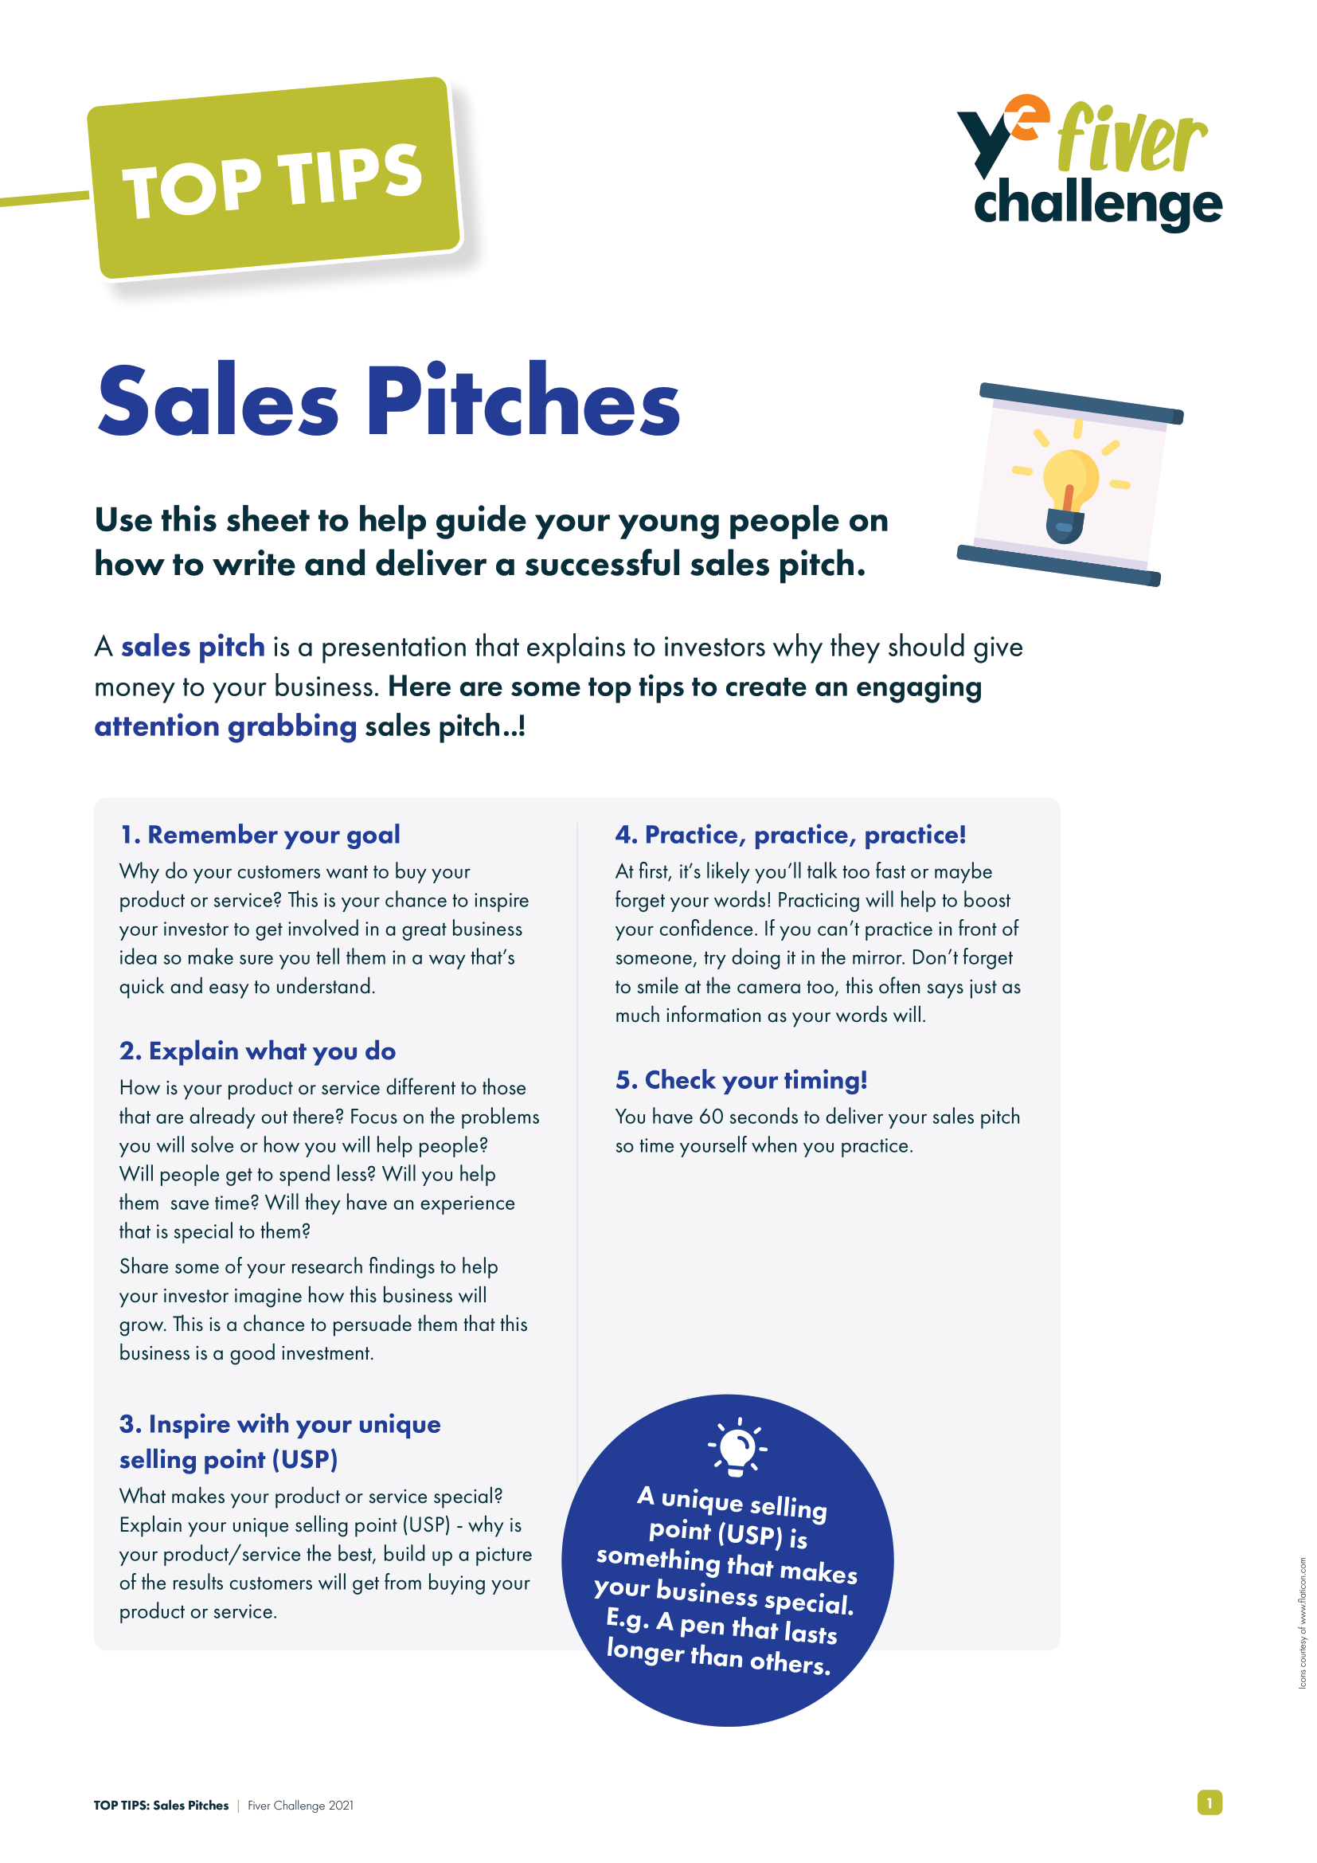
Submit Your Sales Pitch!
Don’t forget to record and submit your sales pitch!
Your pitch should be no more than 60 seconds and should showcase your product or service, its cost, and what makes it unique!
Refer to your Top Tips for Sales Pitches guide if you need to.
Discuss: What do we mean by putting ideas in a logical order and why does it matter? How can creativity contribute to your sales pitch?
Notes:
Teacher Notes
Remind the pupils that they can enter the Sales Pitch Competition. The deadline for submission is the Sunday at the end of Week 3 (check the Fiver website for the exact date).
Skills Builder Essential Skills
Speaking - Step 3: I speak effectively by making points in a logical order
To incorporate the essential skill, ask the following reflective question when covering this slide:
What do we mean by putting ideas in a logical order and why does it matter?
Creativity - Step 3: I generate ideas when I've been given a clear brief
Creativity the use of imagination and the generation of new ideas. To help us to generate ideas we are sometimes provided with a brief. A brief is a problem or challenge that we have to come up with ideas to solve. The brief might be short or long; it might be in a written form, or it might be spoken.
To incorporate the essential skill, ask the following reflective question when covering this slide:
How can creativity contribute to your sales pitch?

Slide 7
Best Sales Pitch 2021 Rhys’ Ring Pulls
Think: How do you take notes at the moment? How can you create ideas to fulfil a brief?
Notes:
Teacher Notes
Show this sales pitch video to your pupils for inspiration and ask what they liked about it.
Skills Builder Essential Skills
Listening - Step 5: I listen to others and record important information as I do
Listening is the skill of receiving, retaining and processing information. Encourage students across the challenge to use their workbook and jot down relevant notes and ideas as they listen. This will help them when they are coming up with their product or service and they might gather information from the great examples in the slides.
To incorporate the essential skill, ask the following reflective question when covering this slide:
How do you take notes at the moment?
Creativity - Step 3: I generate ideas when I've been given a clear brief
To incorporate the essential skill, ask the following reflective question when covering this slide:
How can you create ideas to fulfil a brief?

Slide 8
Week 3 Recap
You have begun to keep track of your spending.
You have decided on your advertising.
You have started to promote your selling event.
You have finished your product or service, ready to sell!
You have entered the Sales Pitch Competition!
You have developed your essential skills.
Notes:
Teacher Notes
This slide reminds pupils of what they have achieved at the end of Week 3!

Slide 9
COMPLETE
Well done, you have completed Week 3!

